Slide 1



Noida Institute of Engineering and Technology, Greater Noida
Semiconductor Diode and its Applications
Unit: 4
Basic Electrical and Electronics Engineering
Kashika Baranwal
(EN Department)
B.Tech 1st/2nd Sem

Slide 2
Content
Introduction to Semiconductors: Intrinsic and Extrinsic
P-N Junction Diode
Depletion Layer
V-I Characteristic
Application of Diodes
Half and Full wave Rectification
Clippers and numerical Problem
Breakdown Mechanism: Zener and Avalanche
Zener Diode as shunt regulator
Display Devices
Liquid Crystal Display (LCD)
Light Emitting Diode (LED) AND Organic-LED (O-LED)
Seven Segment Display

Slide 3
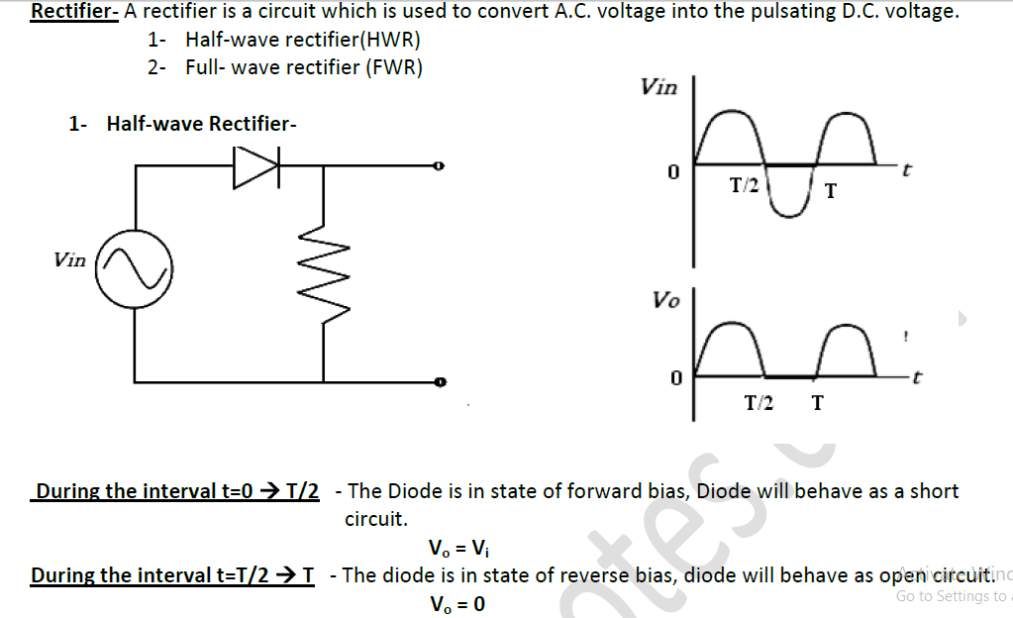
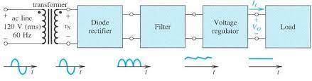
Rectifier Circuits

Slide 4
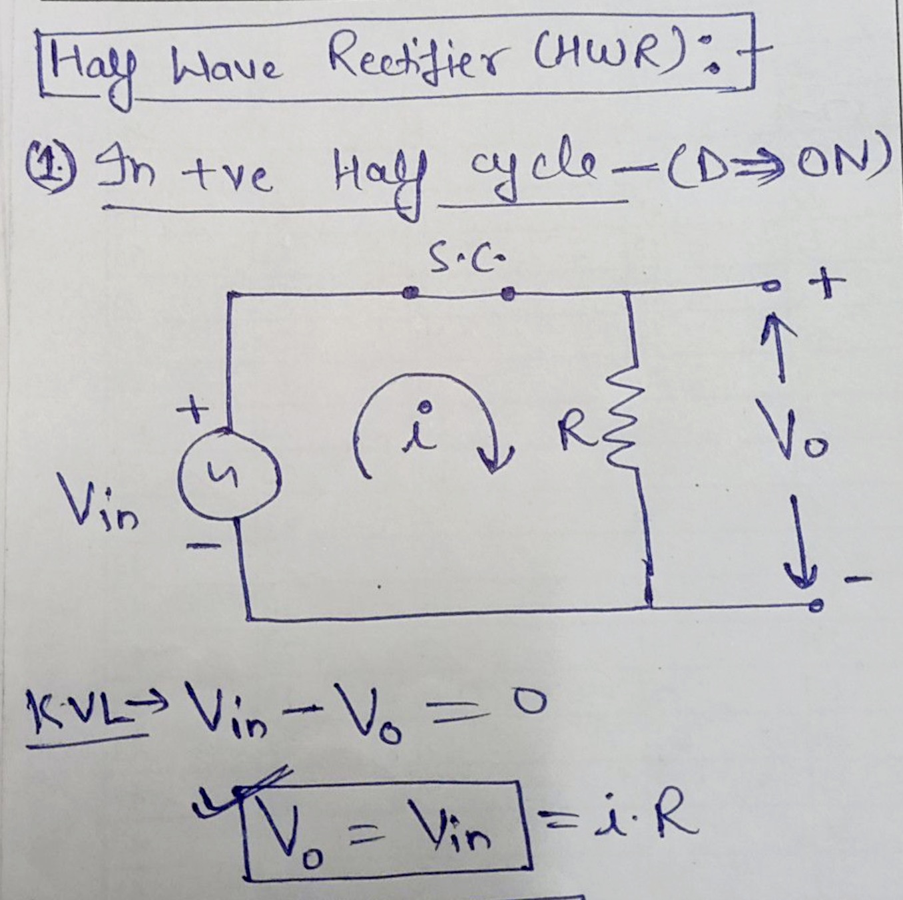
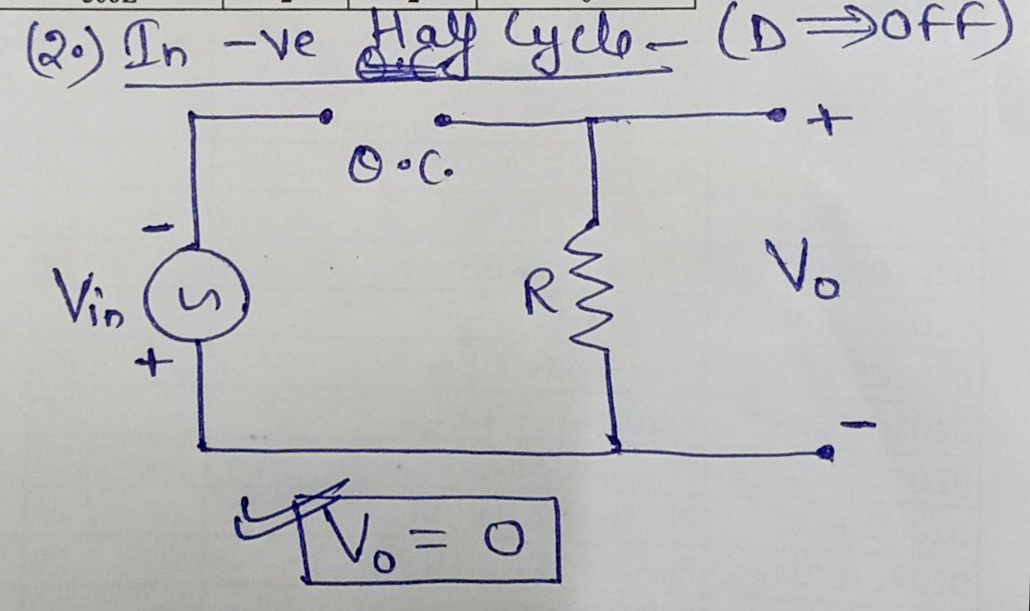
Half Wave Rectifier

Slide 5
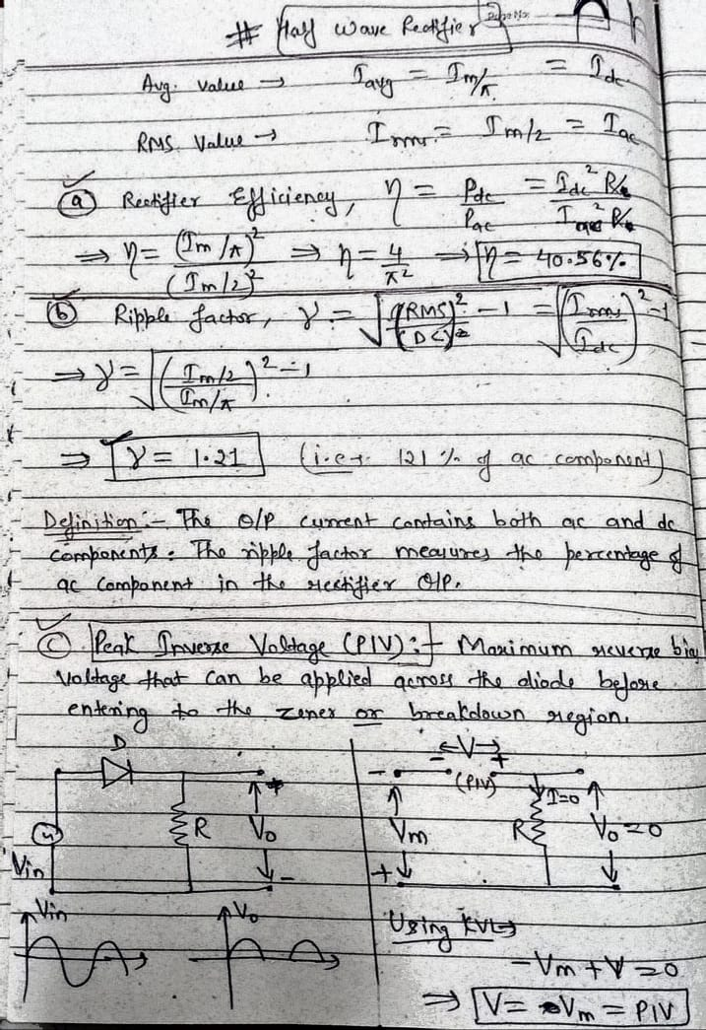
Half Wave Rectifier

Slide 6
Half Wave Rectifier

Slide 7
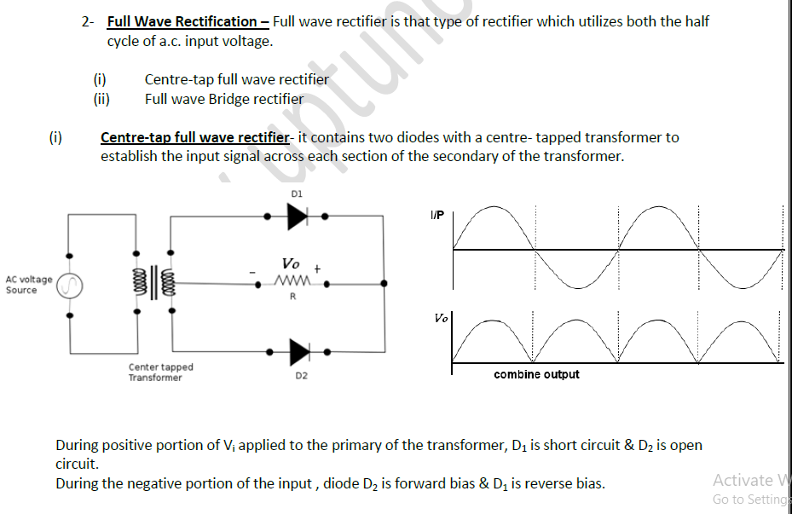
Full Wave Rectifier

Slide 8
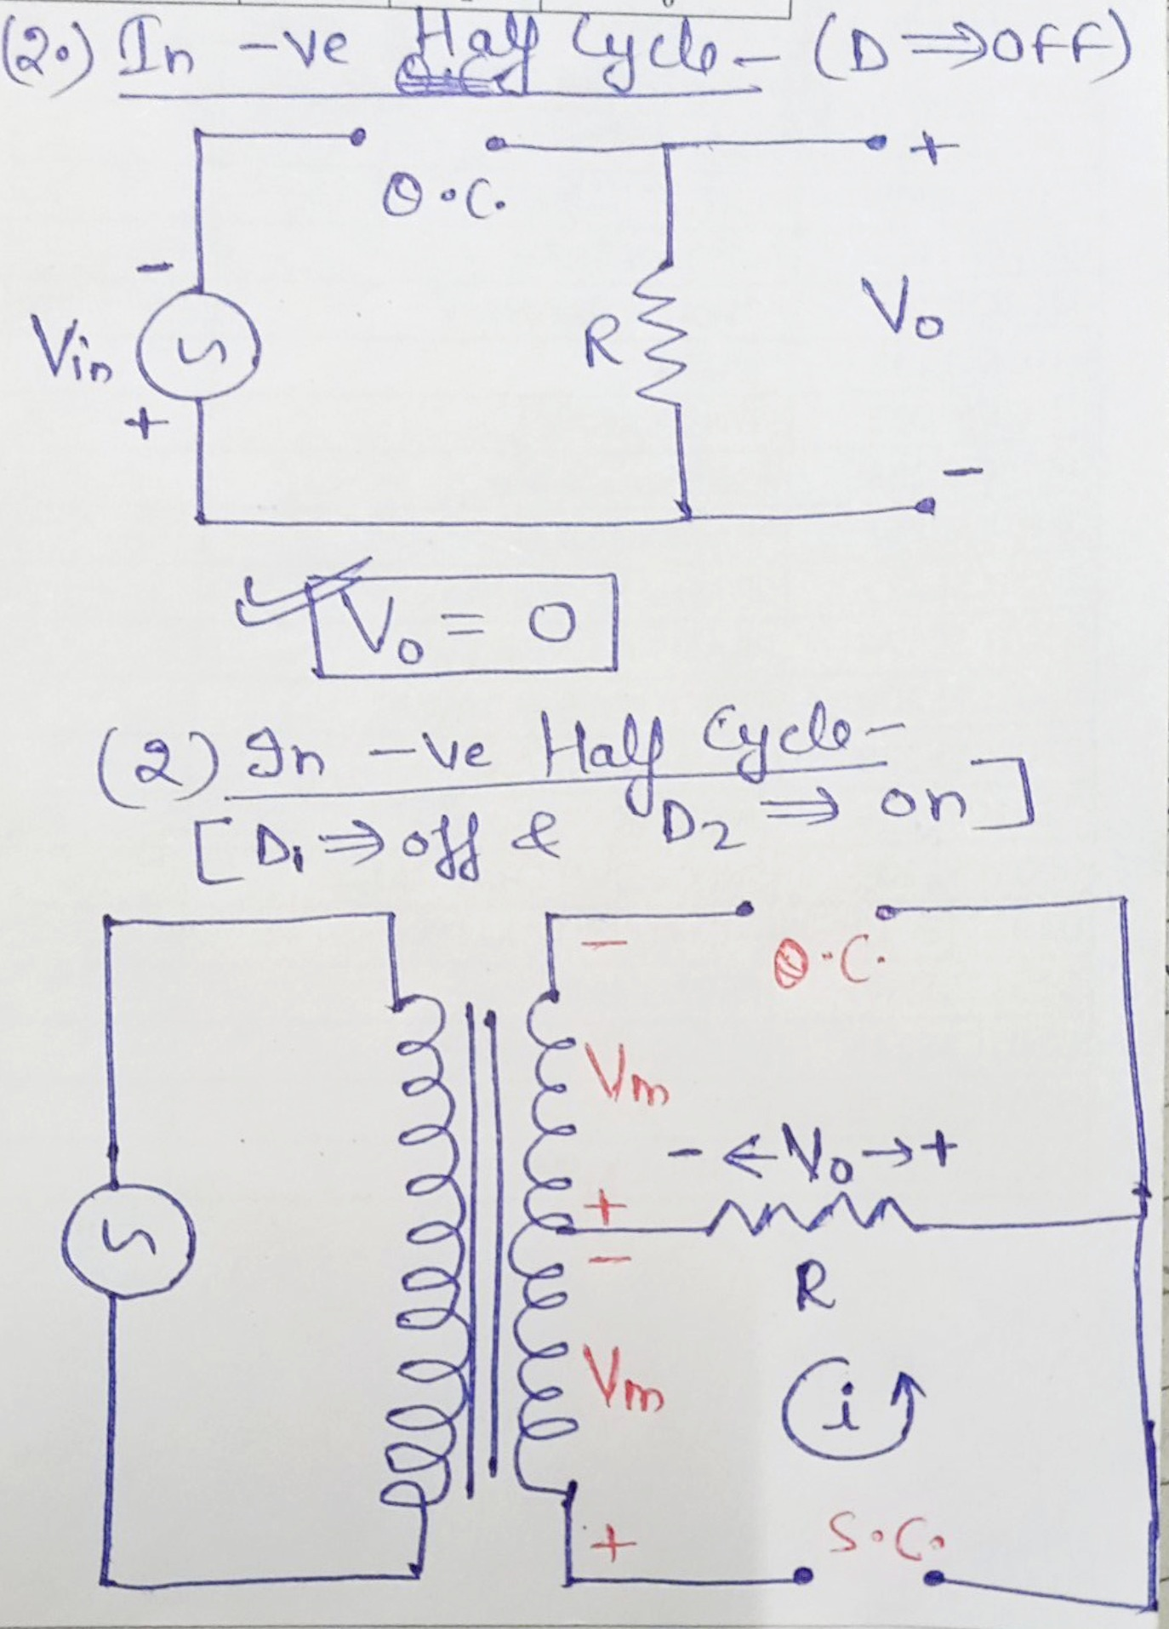
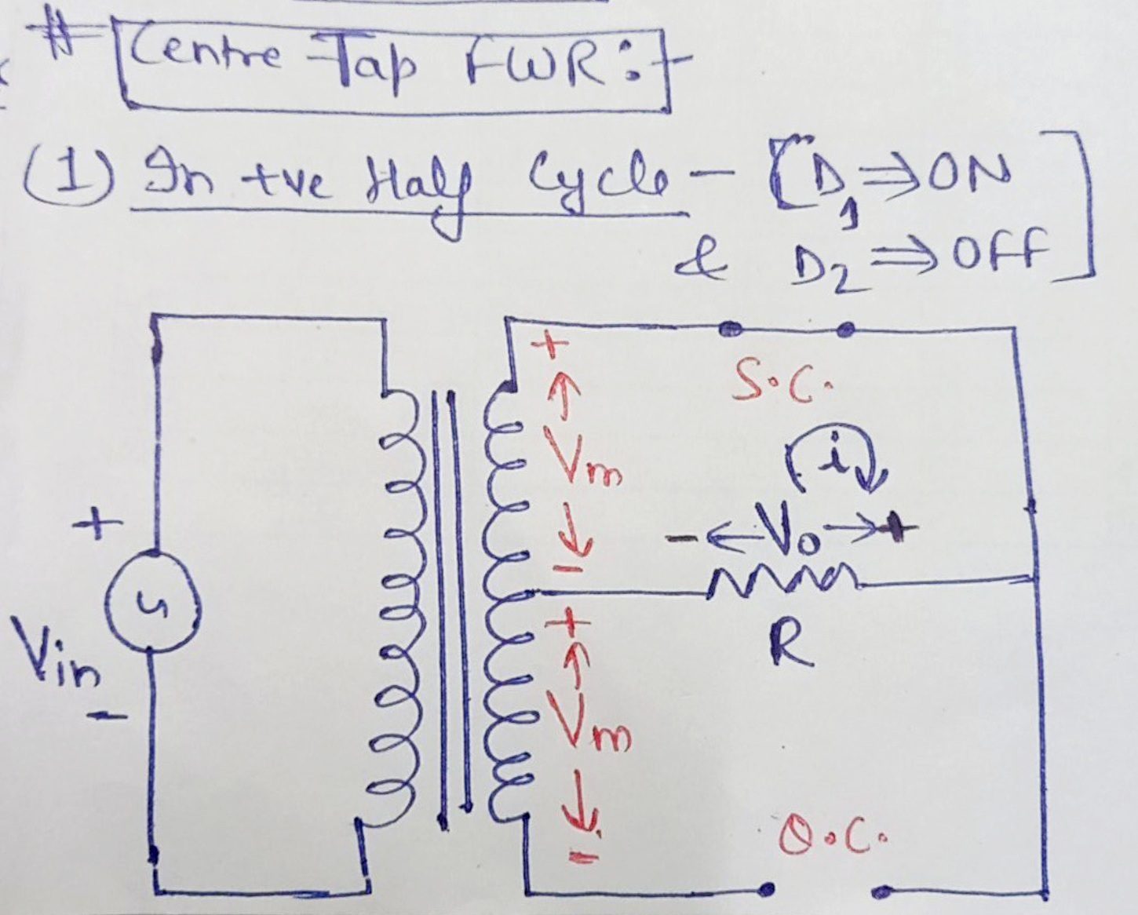
Centre Tap Full Wave Rectifier

Slide 9
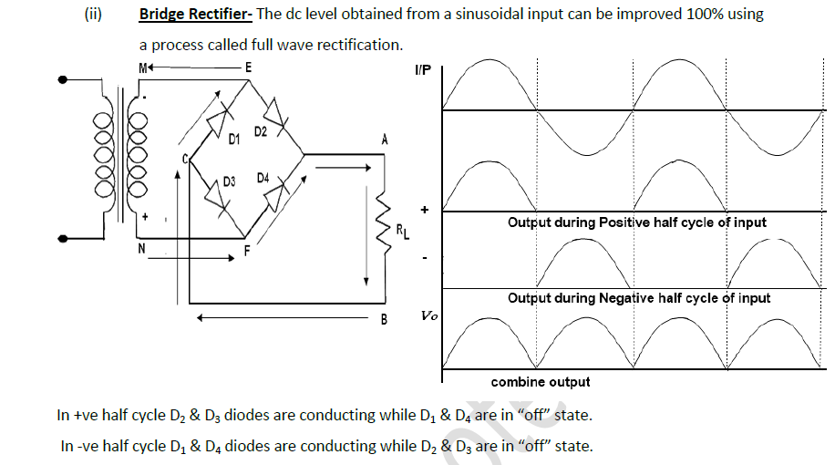
Full Wave Rectifier

Slide 10
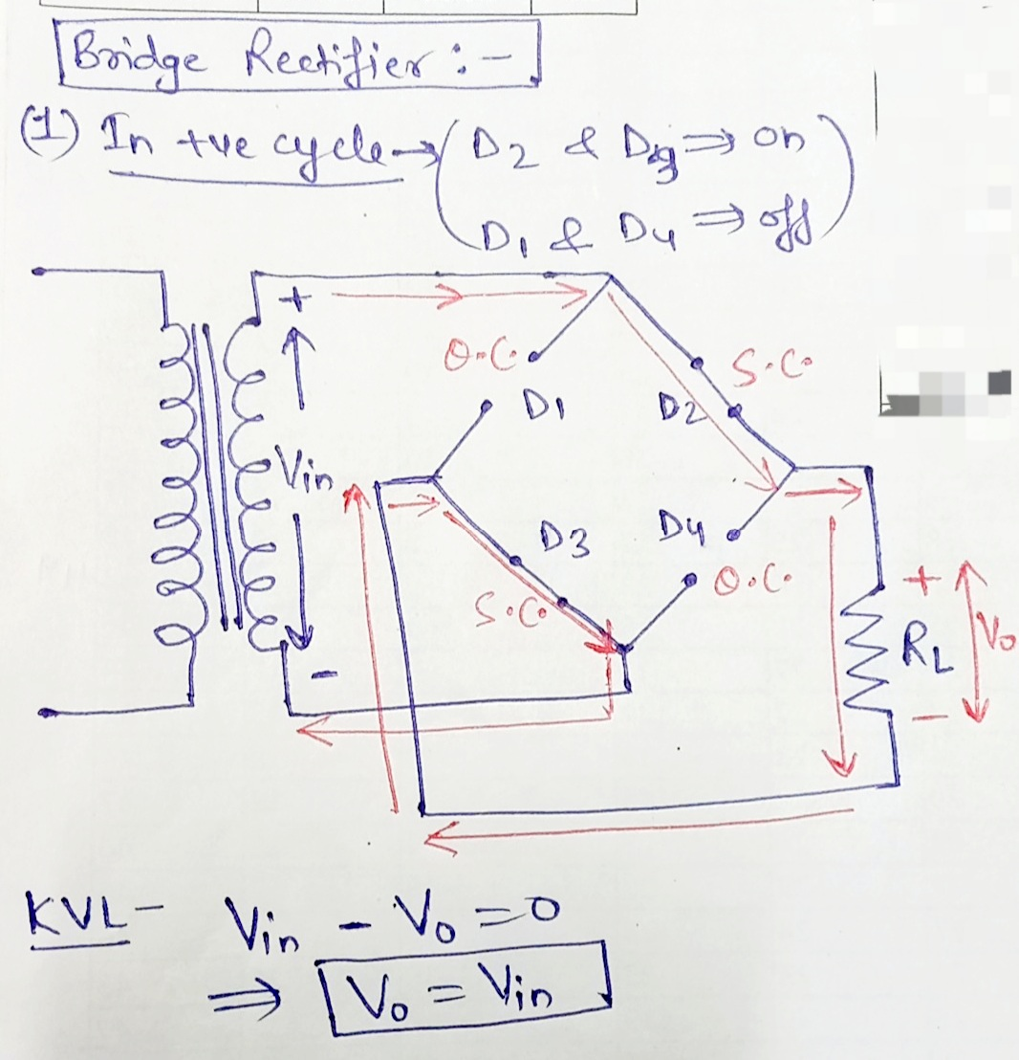
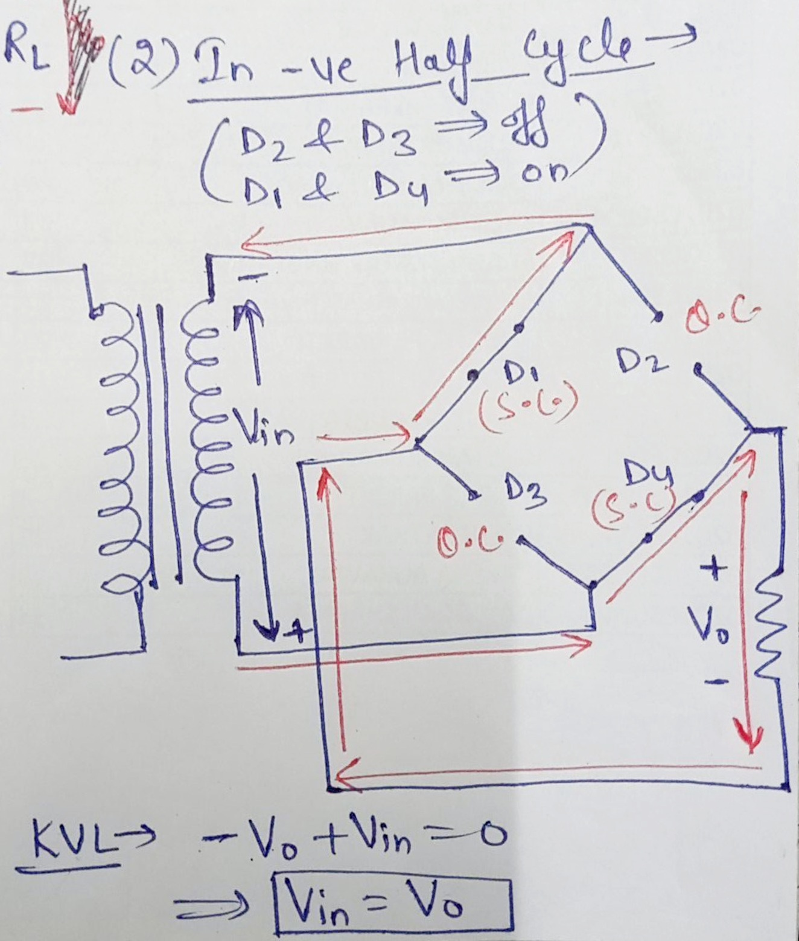
Bridge Rectifier

Slide 11
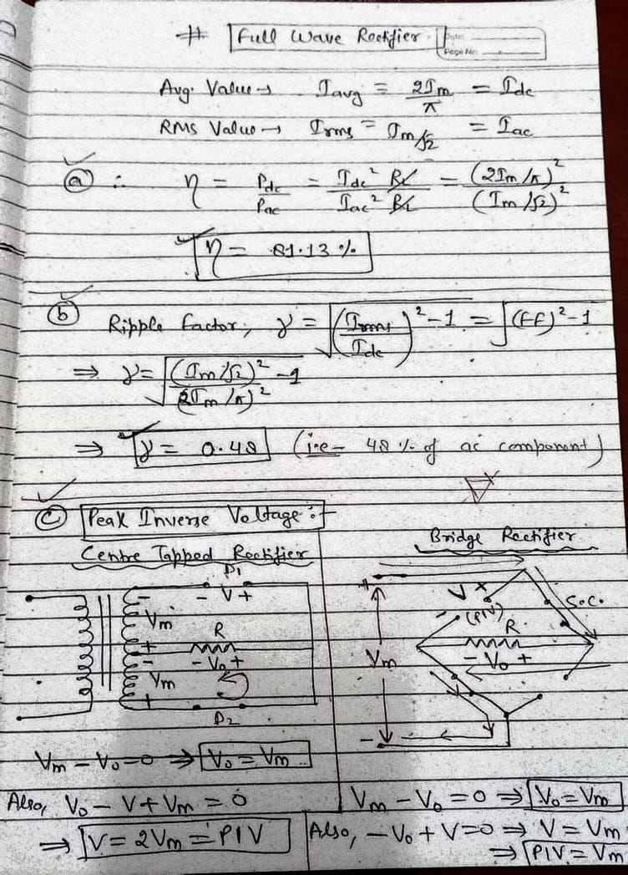
Half Wave Rectifier

Slide 12
Half Wave Rectifier

Slide 13
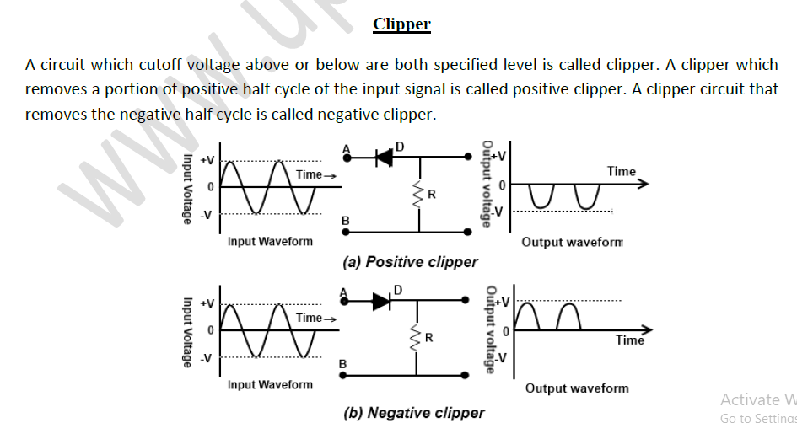
Clipper Circuits

Slide 14
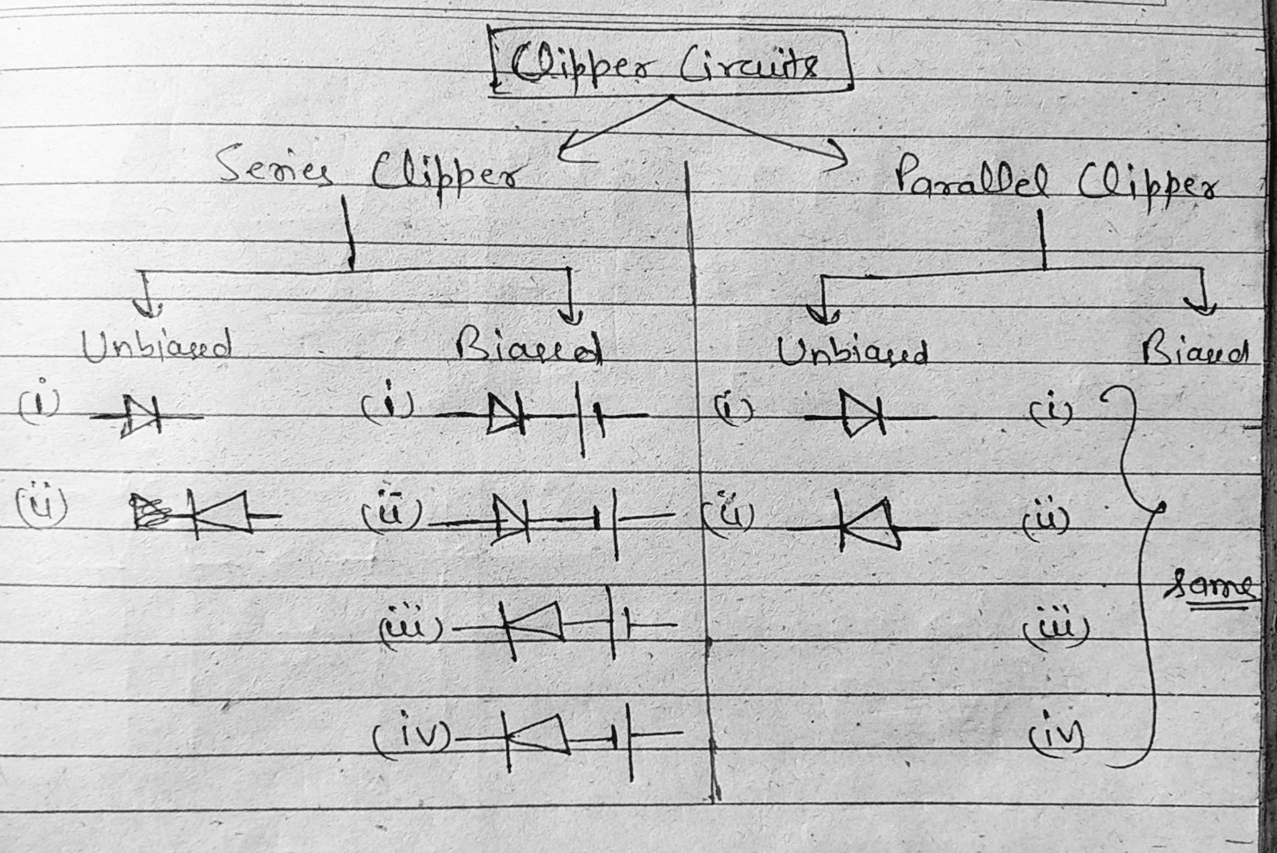
Unbiased Series Clipper Circuits

Slide 15
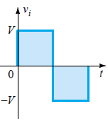
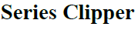
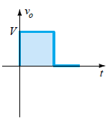
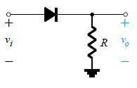
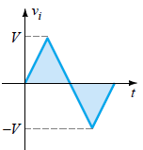
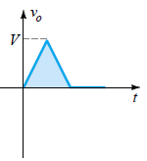
Diodes – Wave-Shaping Circuits
Clipper Circuits

Slide 16
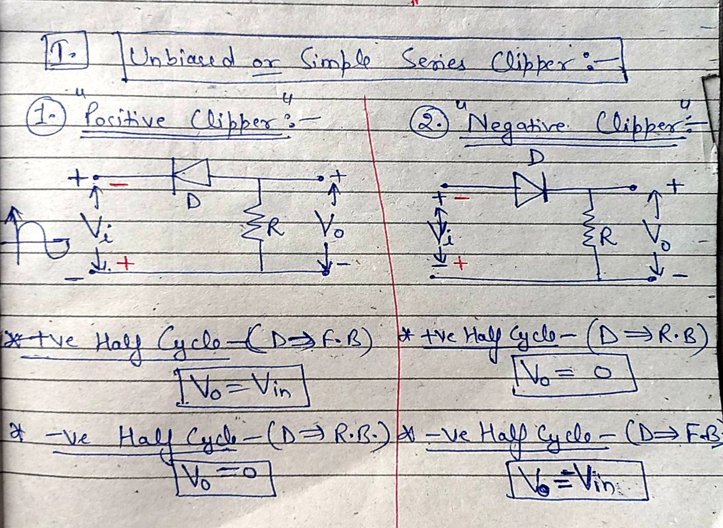
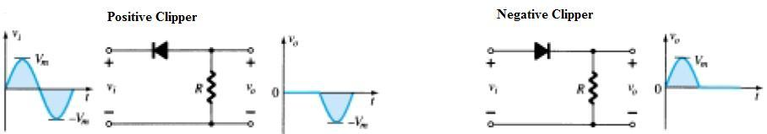
Unbiased Series Clipper Circuits

Slide 17
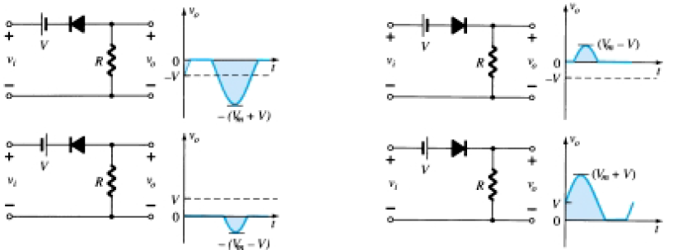
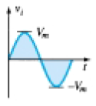
Different Types of Series Clipping Circuits
Simple Series Clippers (Ideal Diodes)
Biased Series Clippers (Ideal Diodes)

Slide 18
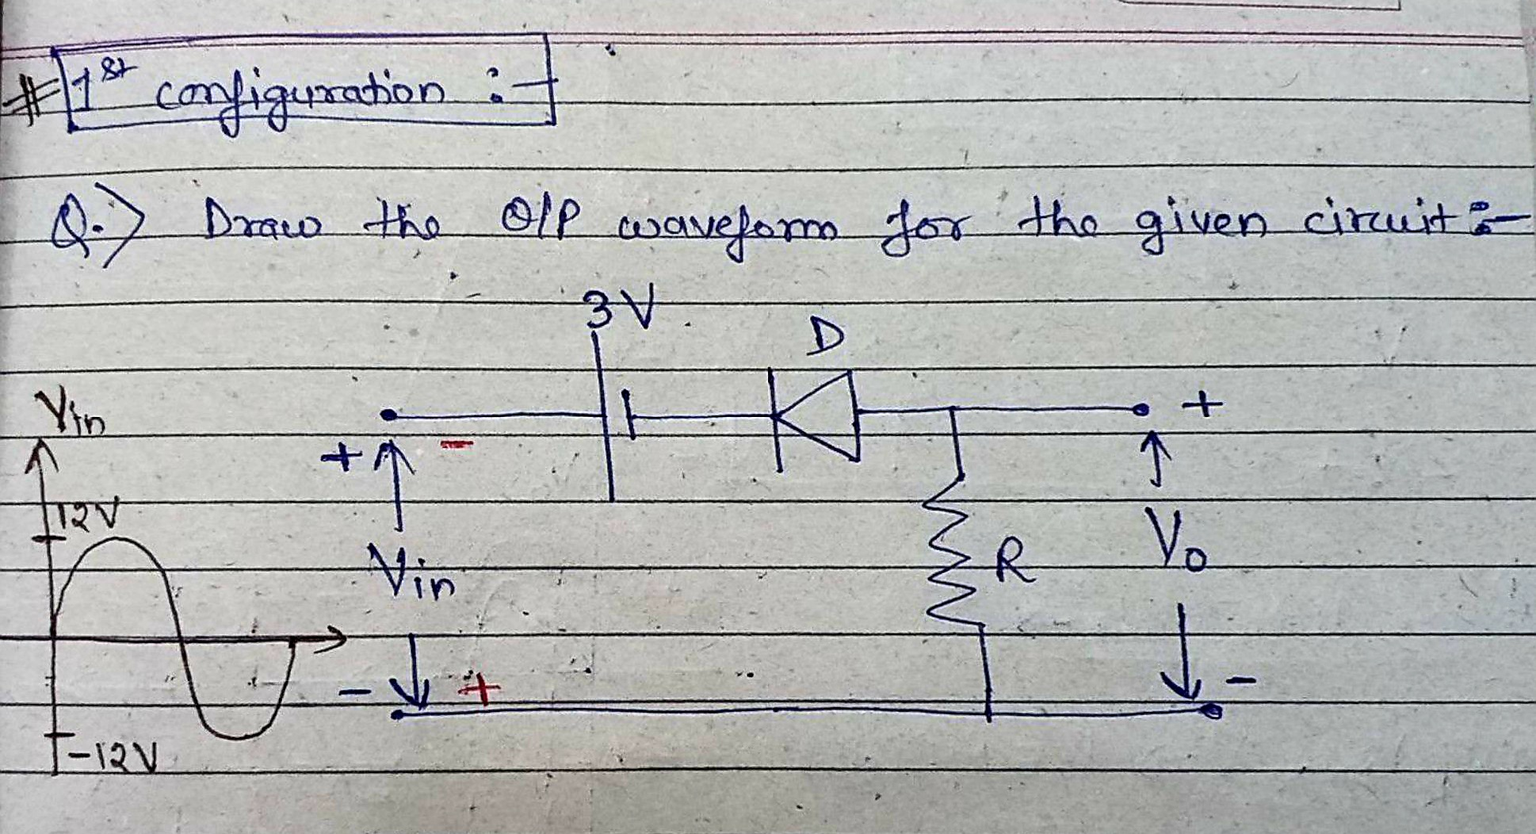
Biased Series Clipper Circuit-1

Slide 19
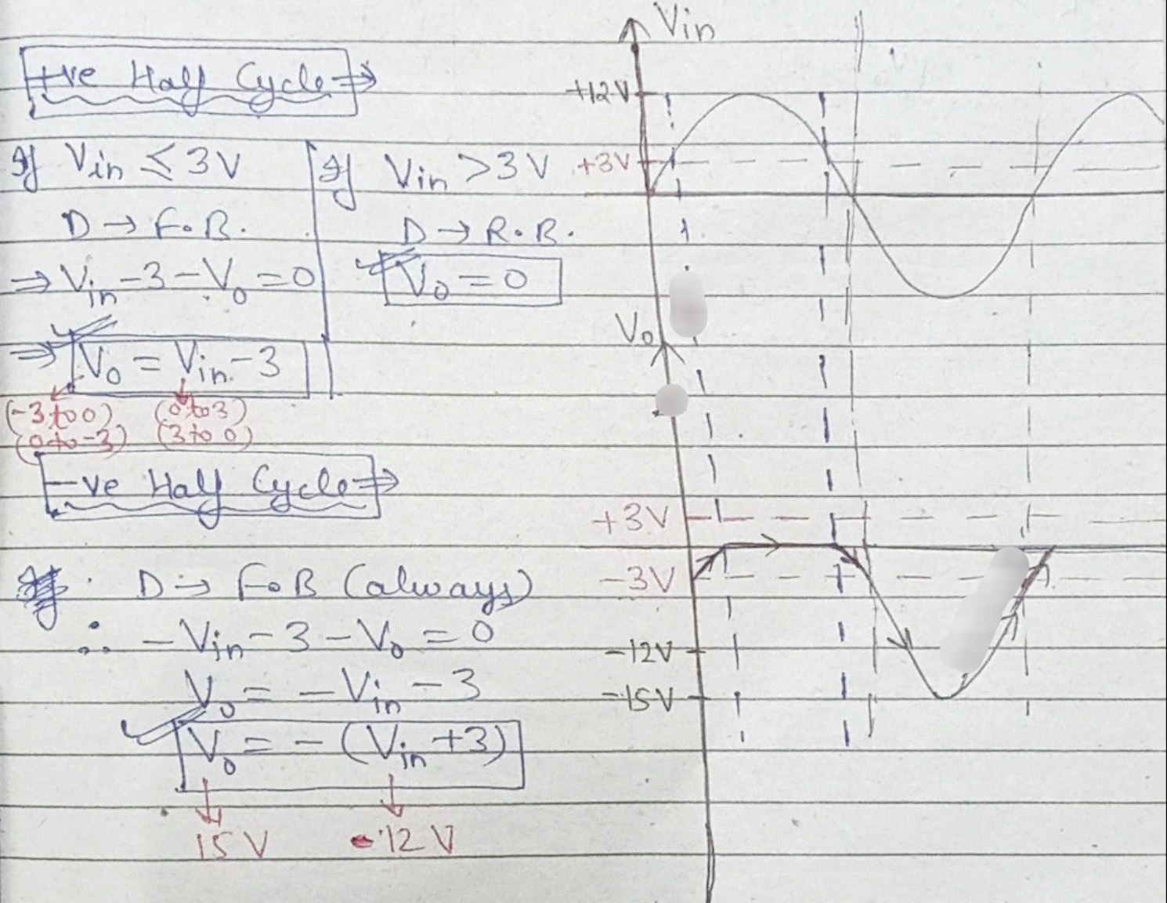
Biased Series Clipper Circuit-1

Slide 20
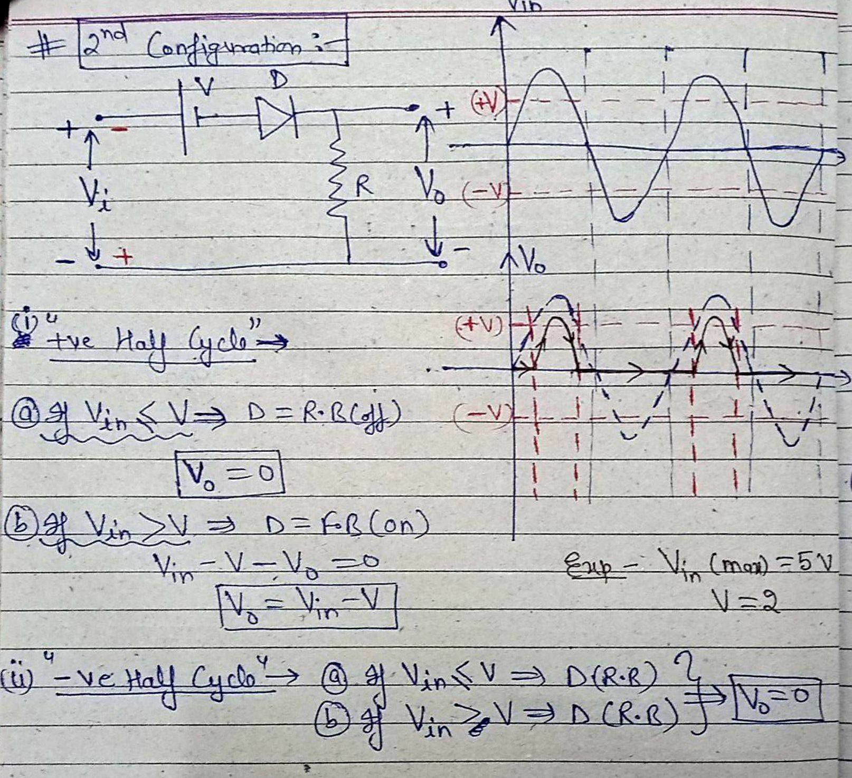
Biased Series Clipper Circuit-2

Slide 21
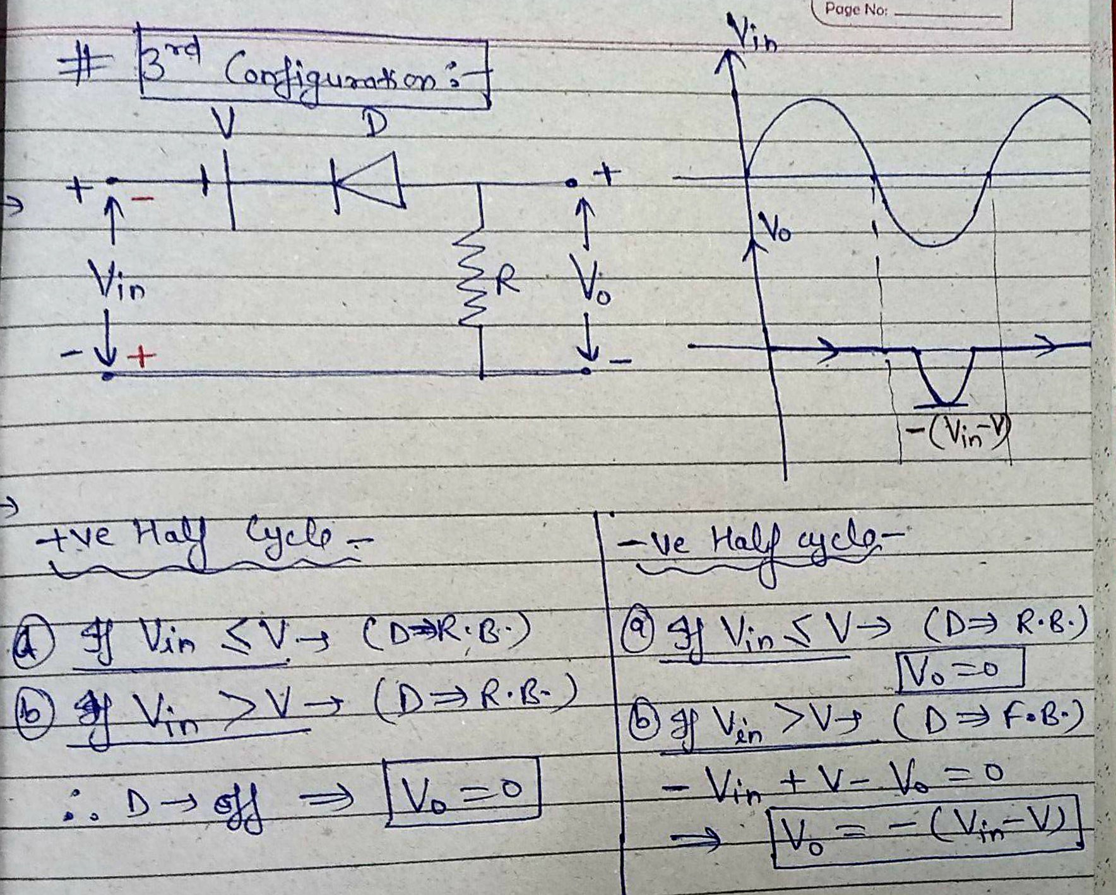
Biased Series Clipper Circuit-3

Slide 22
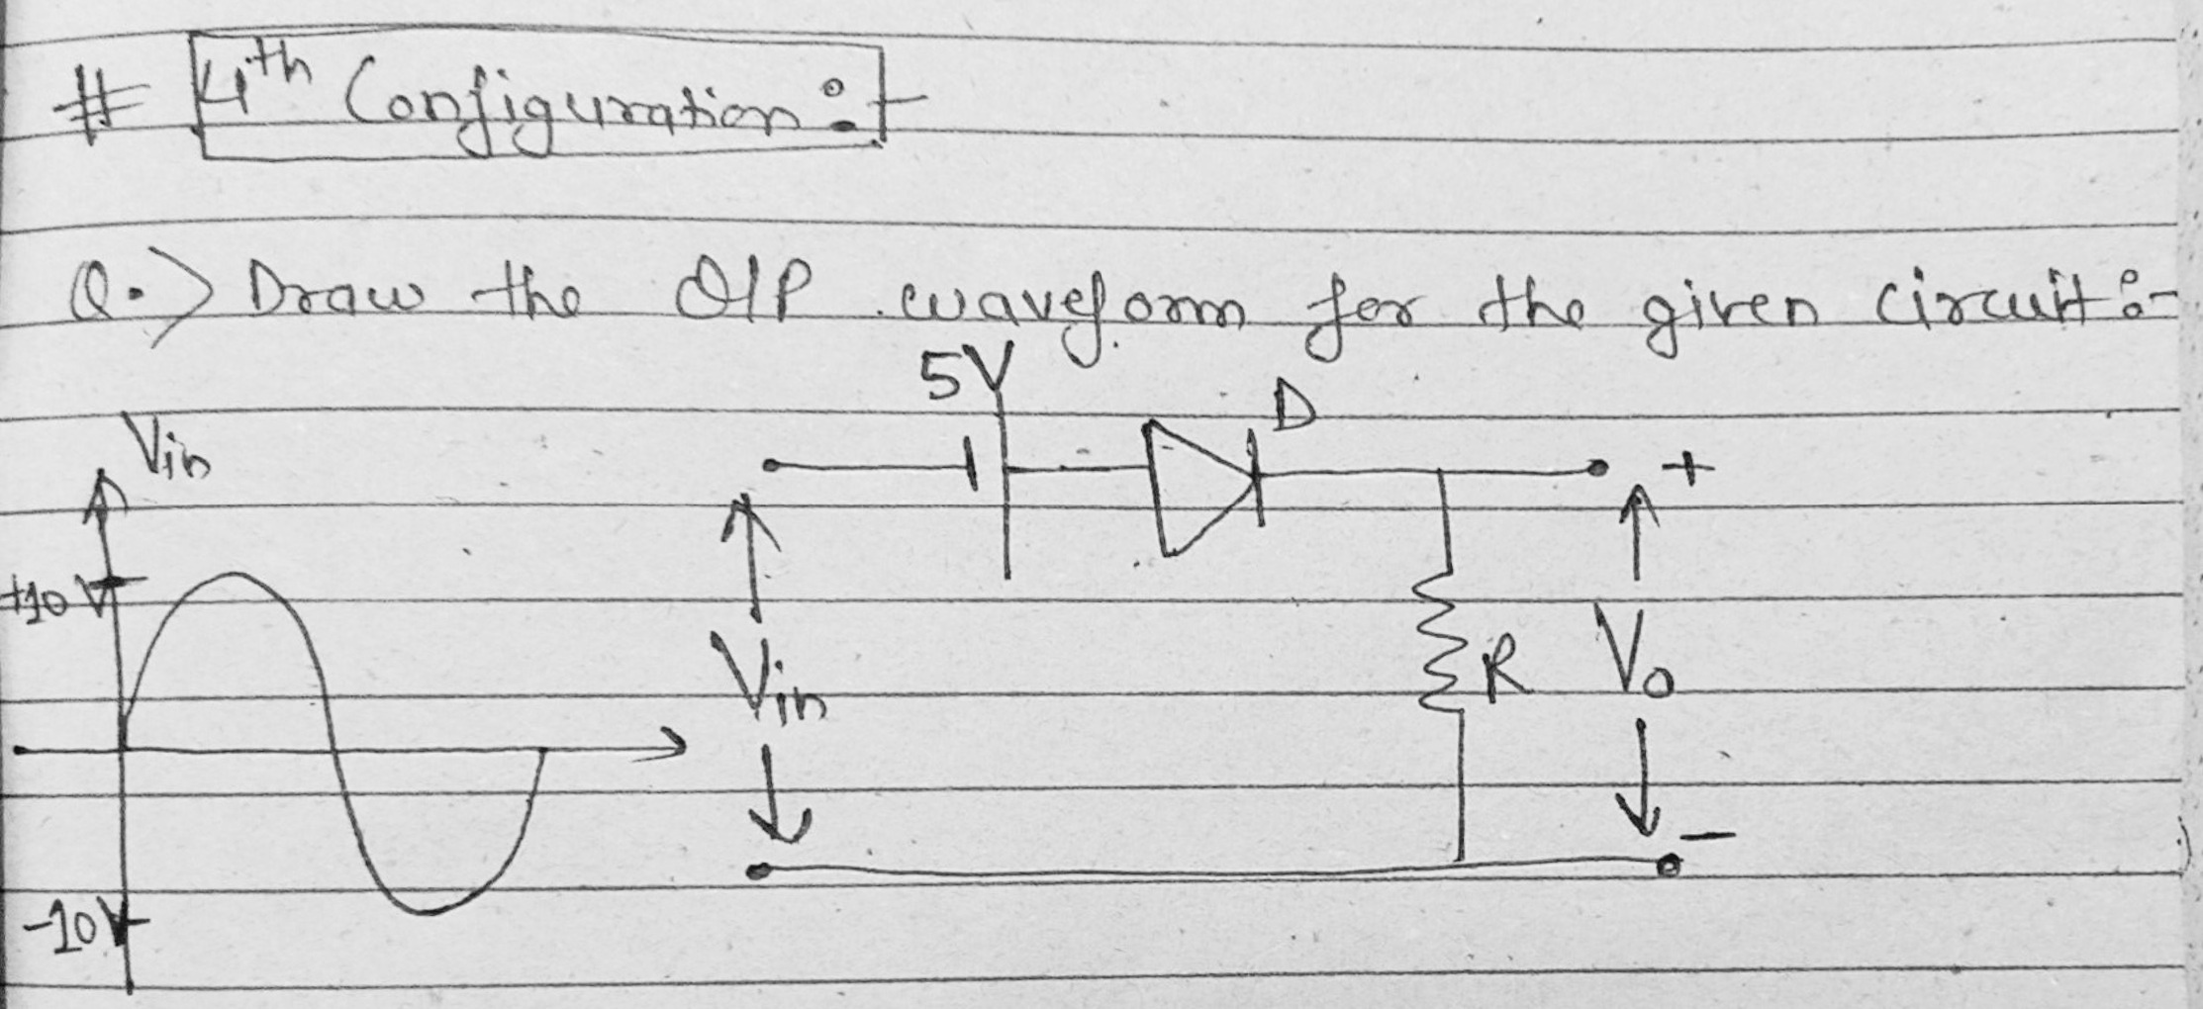
Biased Series Clipper Circuit-4

Slide 23
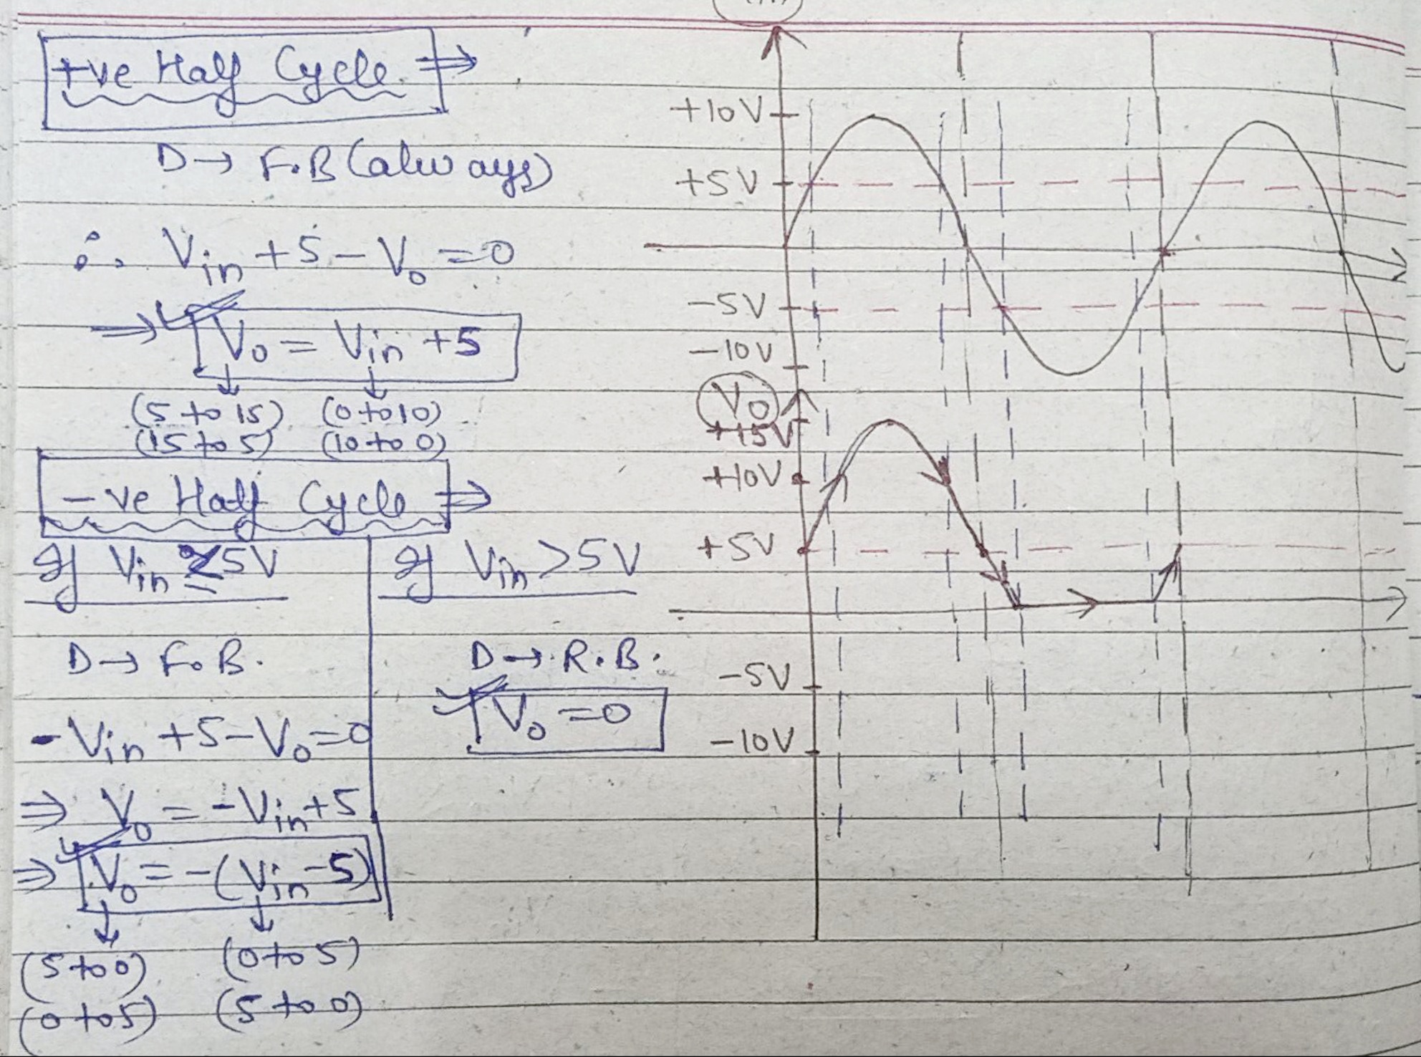
Biased Series Clipper Circuit-4

Slide 24
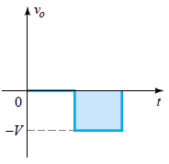
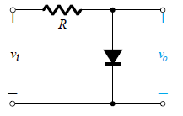
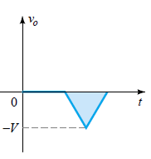
Clipper Circuits

Slide 25
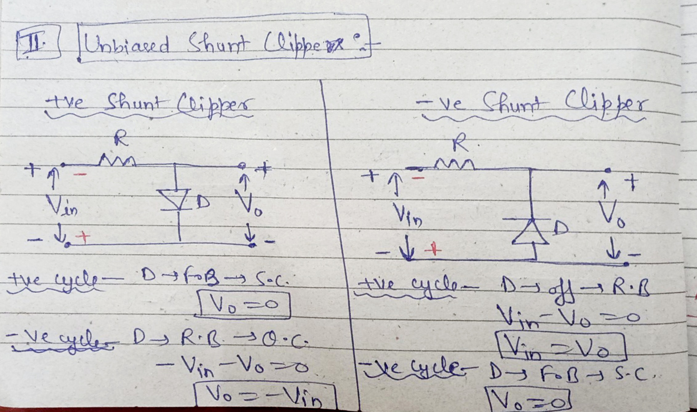
Unbiased Shunt Clipper Circuits

Slide 26
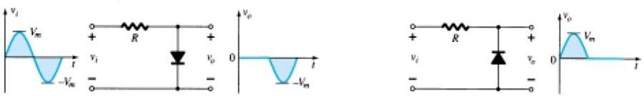
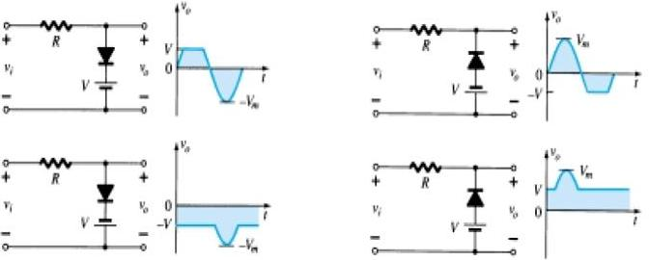
Different Types of Shunt Clipping Circuits
Simple Parallel Clippers (Ideal Diode)
Biased Parallel Clippers (Ideal Diode)

Slide 27
Different Types of Shunt Clipping Circuits
Simple Parallel Clippers (Ideal Diode)
Biased Parallel Clippers (Ideal Diode)

Slide 28
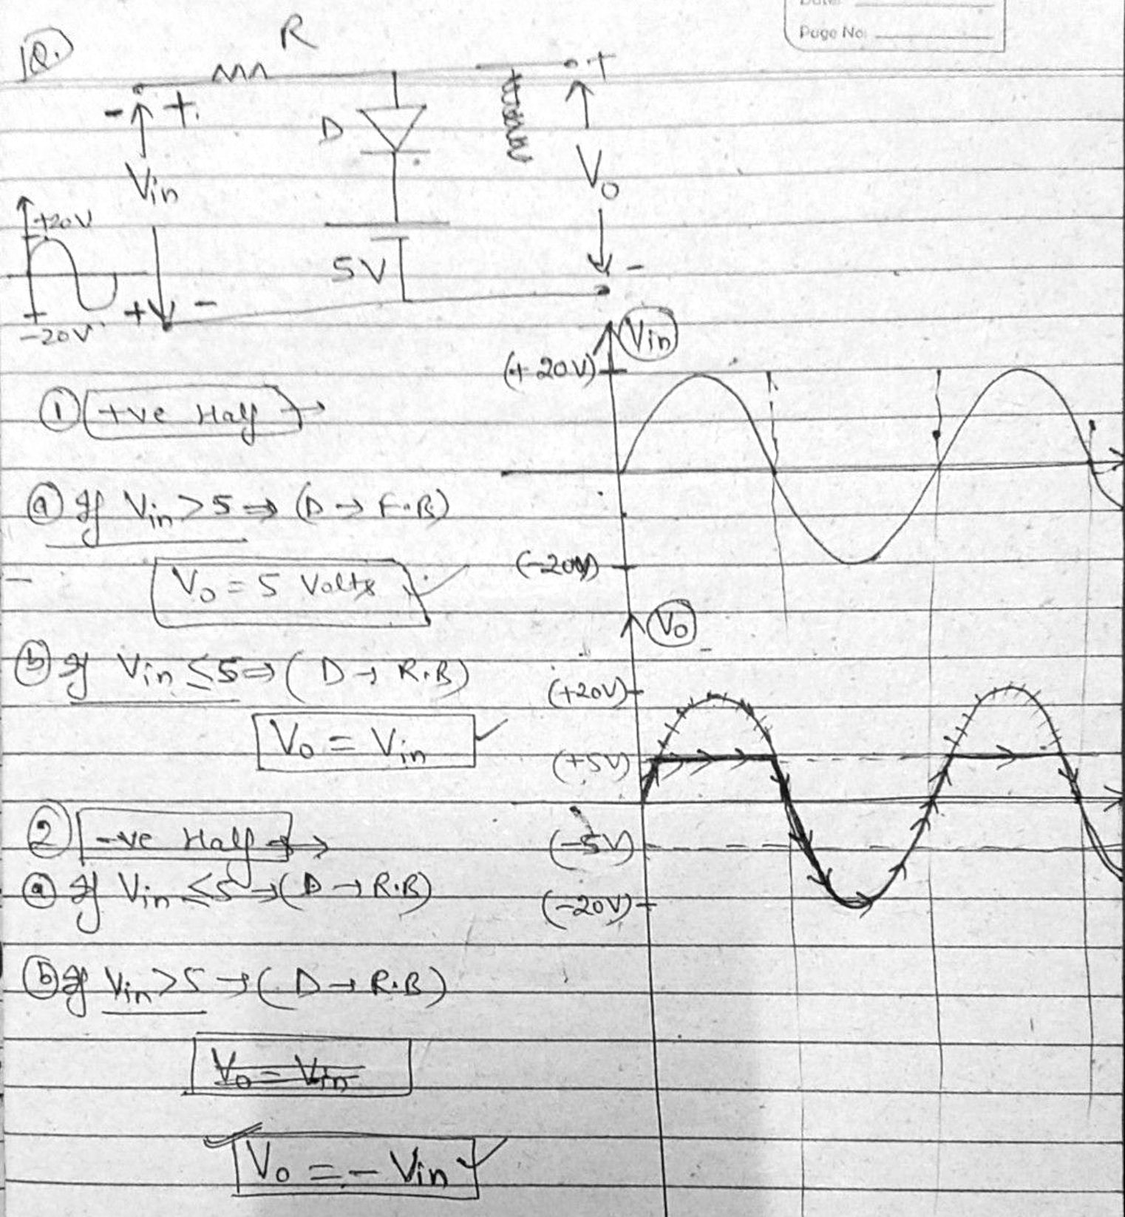
Biased Shunt Clipper Circuit-3

Slide 29
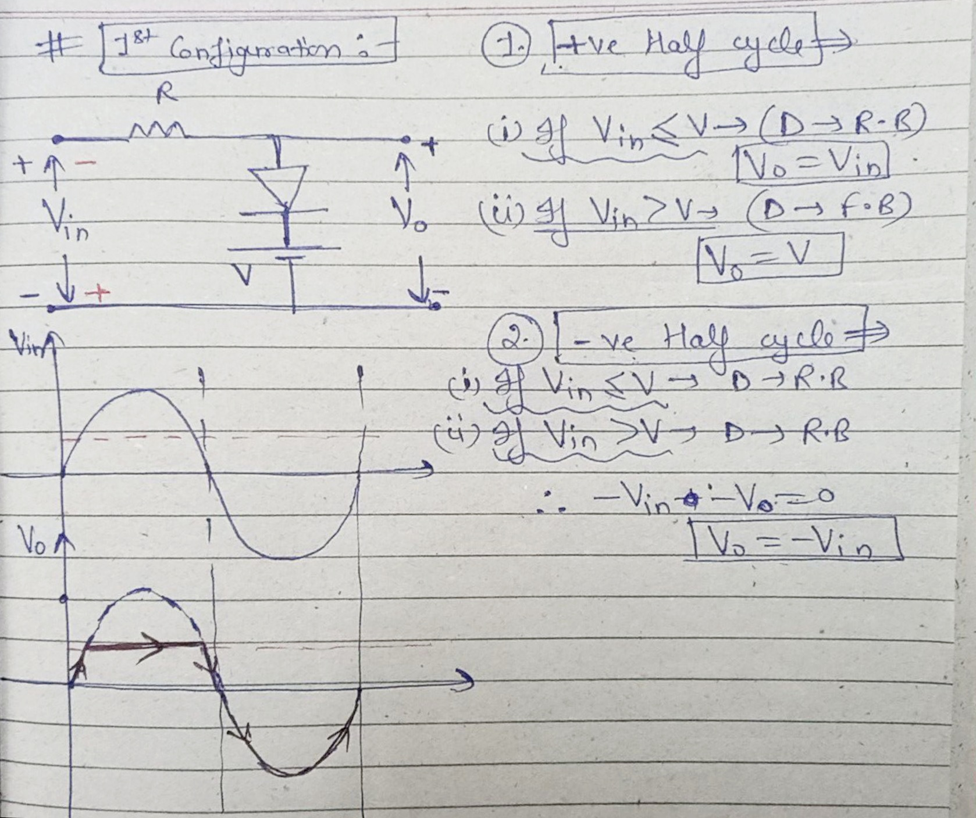
Biased Shunt Clipper Circuit-1

Slide 30
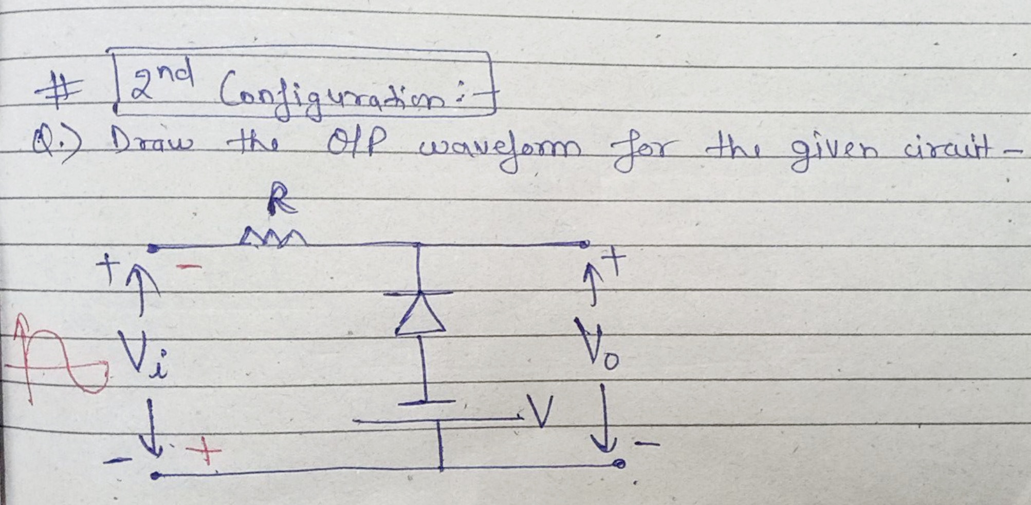
Biased Shunt Clipper Circuit-2

Slide 31
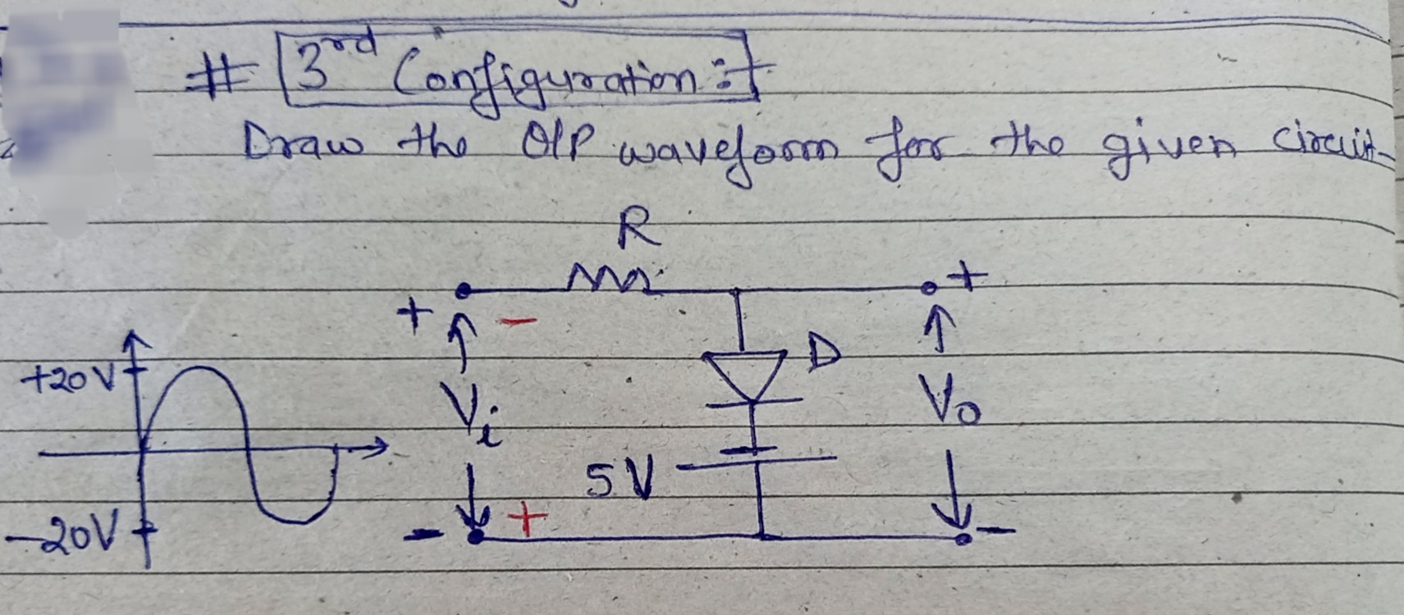
Biased Shunt Clipper Circuit-3

Slide 32
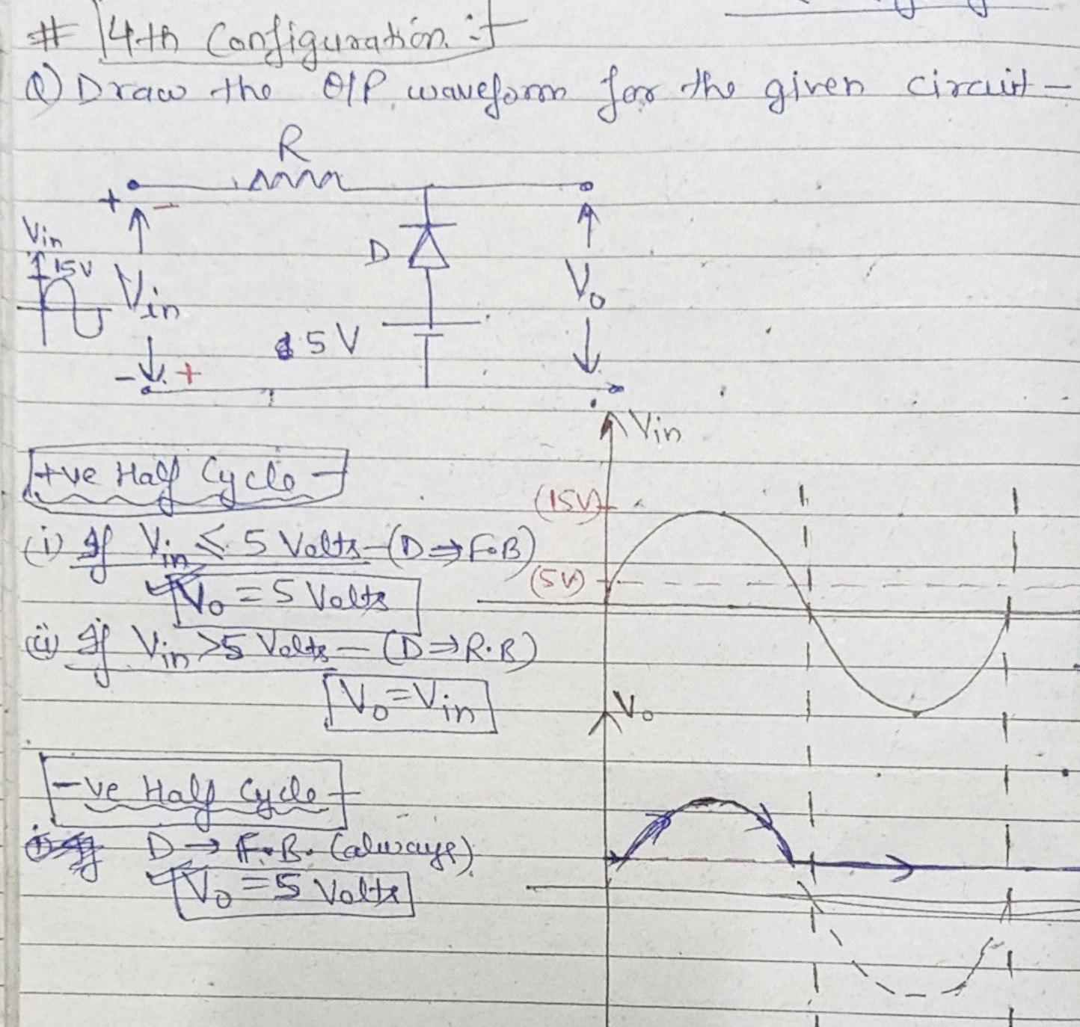
Biased Shunt Clipper Circuit-4

Slide 33
Biased Shunt Clipper Circuit-4

Slide 34
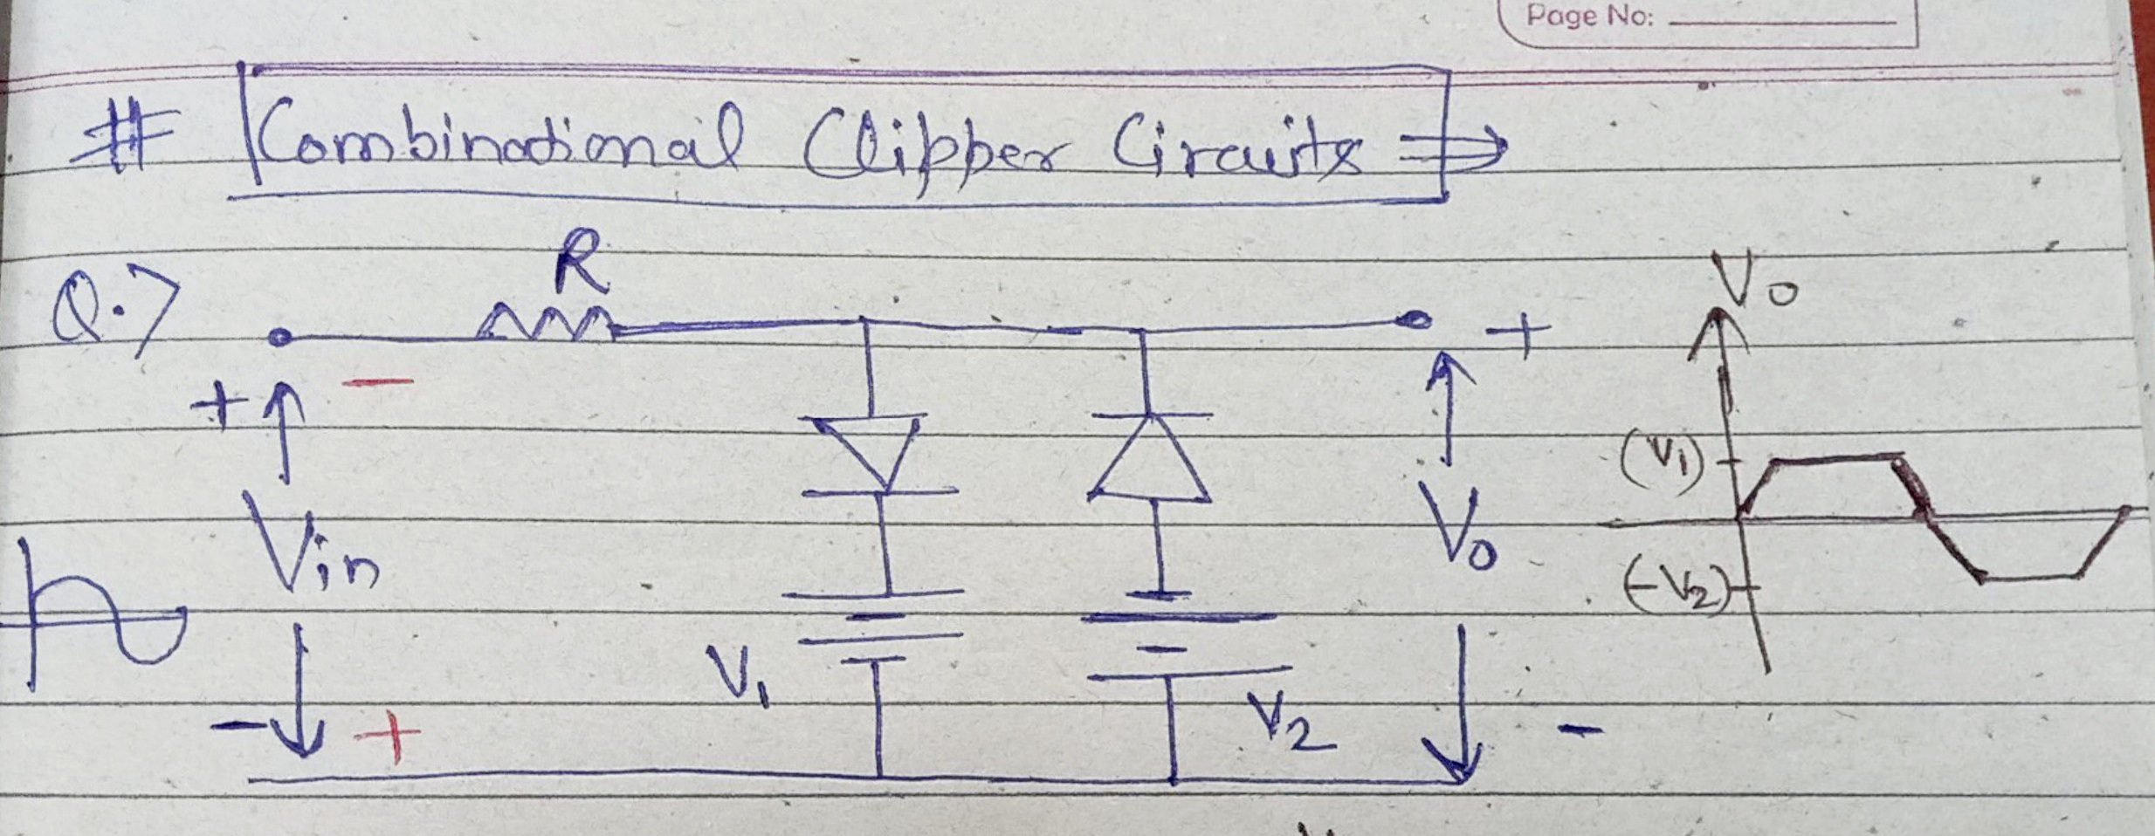
Combinational Clipper Circuit

Slide 35
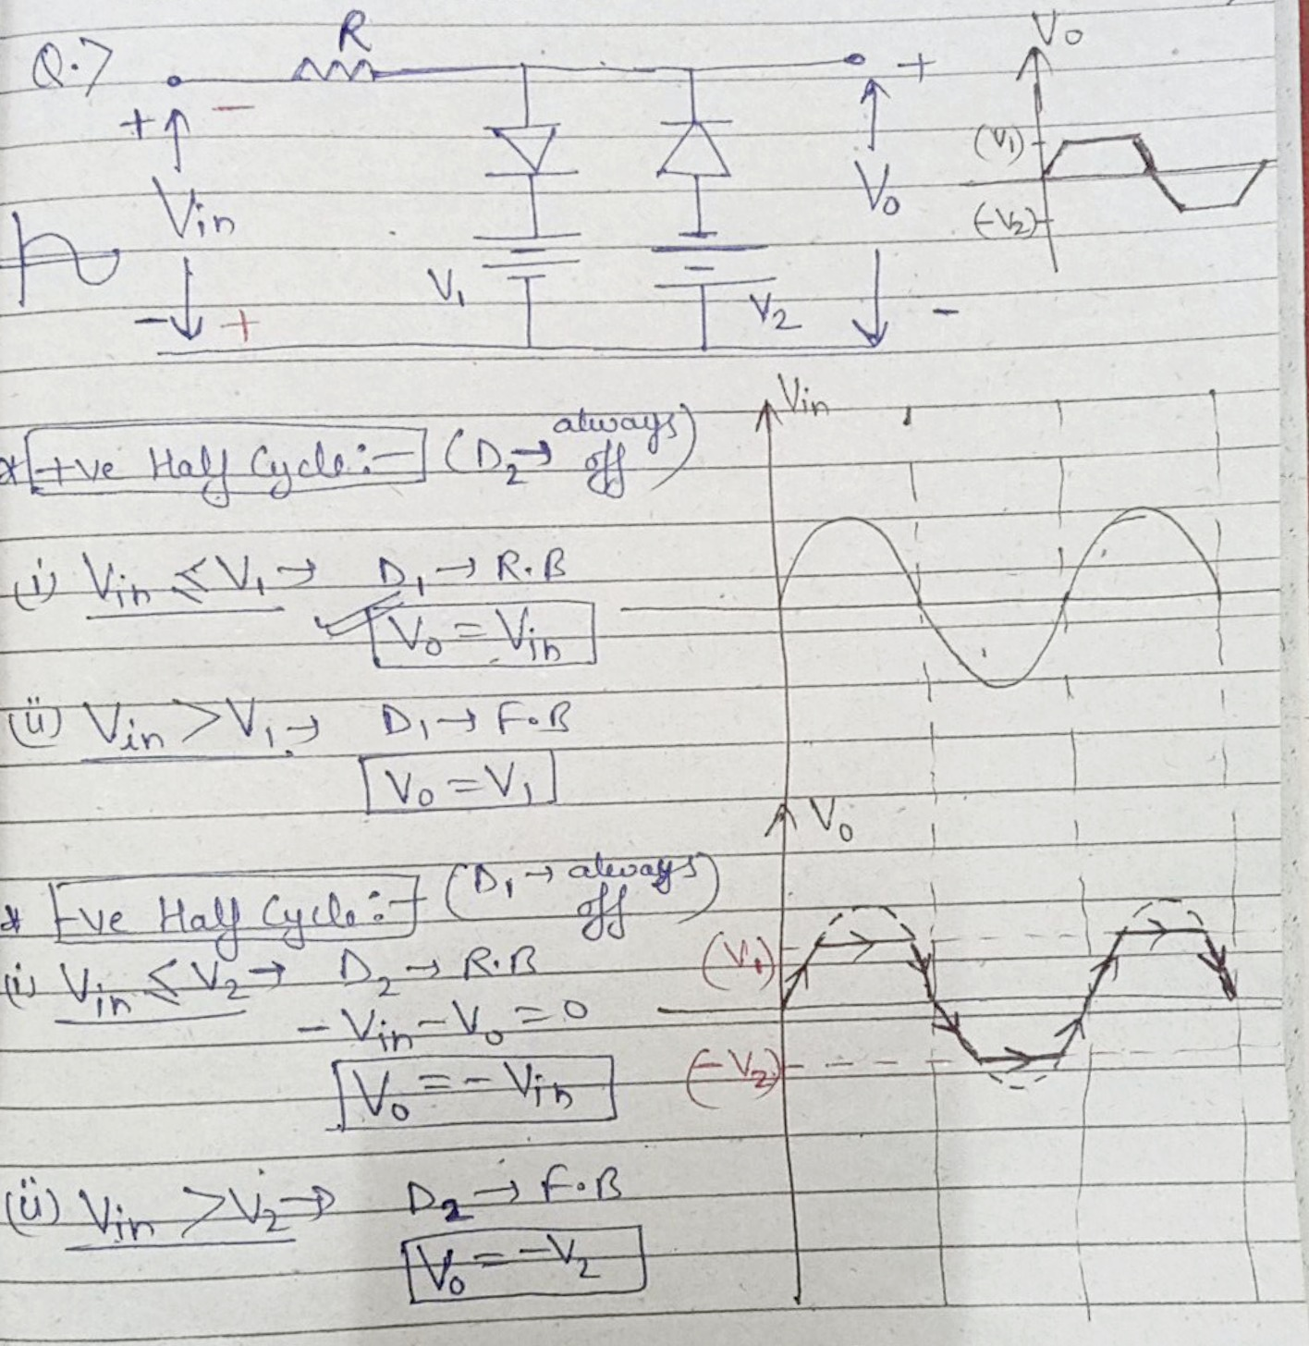
Combinational Clipper Circuit

Slide 36
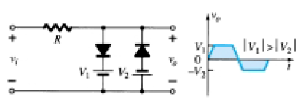
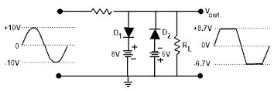
Combinational Clipper Circuit
Combination Clipper Circuits (2005-06, 2011-12)
Example: Sketch the output

Slide 37
Introduction to Display Devices
Name of Topic | Duration (Lectures) | (%) Assignment coverage | % of marks in exams
Light Emitting Diode (LED), O-LED Liquid - Crystal Displays (LCD) | 2 | 20 | 5-10

Slide 38
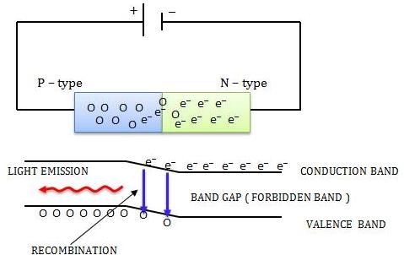
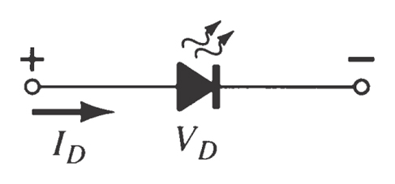
Light Emitting Diode (LED)
An LED emits light when it is forward biased, which can be in the infrared or visible spectrum.
The forward bias voltage is usually in the range of 2 V to 3 V.
LED Symbol

Slide 39
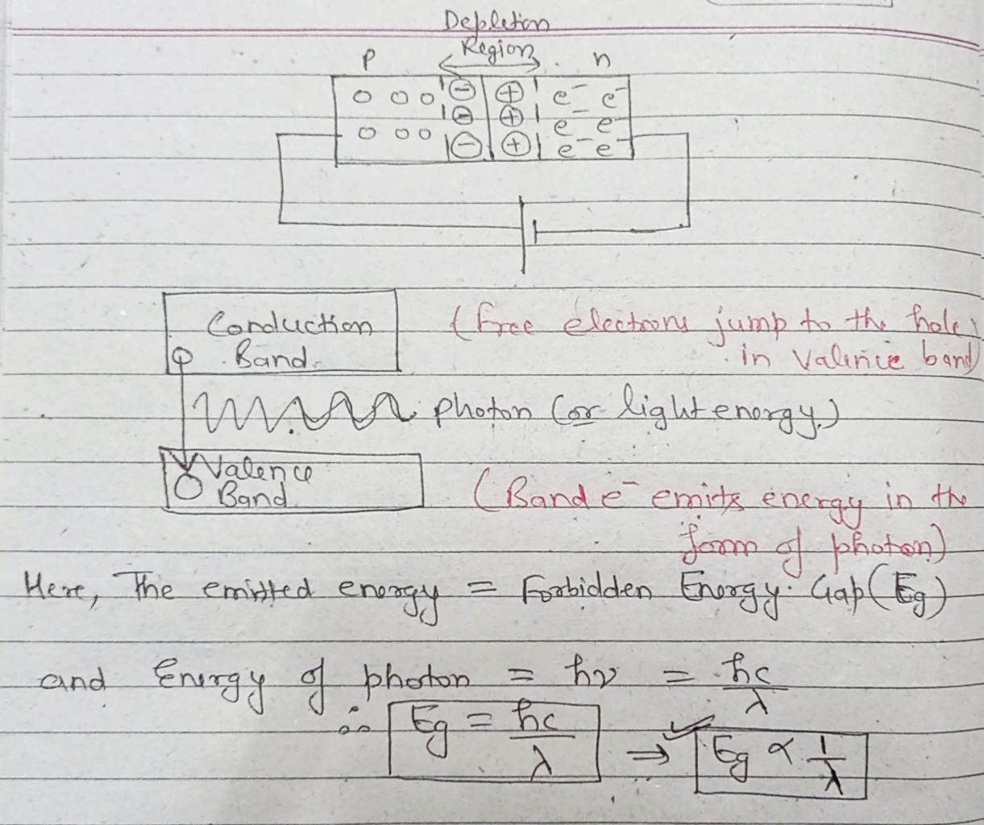
Light Emitting Diode (LED)

Slide 40
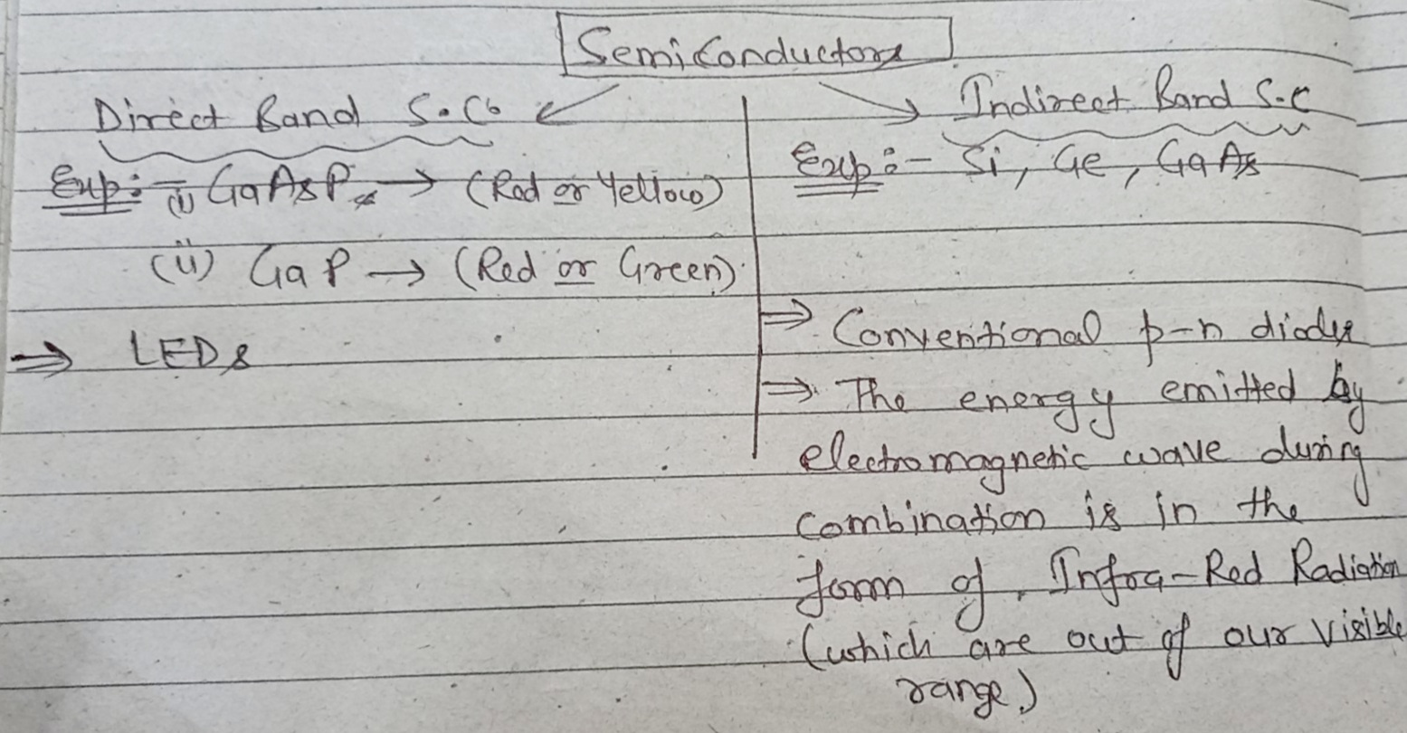
Light Emitting Diode (LED)

Slide 41
Materials of LED
S. No. | Material | Symbol | Colour
1 | Gallium Arsenide | GaAs | Infrared (invisible)
2 | Gallium Phosphide | GaP | Red or Green
3 | Gallium Arsenide Phosphide | GaAsP | Red or Yellow

Slide 42
Advantages & Disadvantages of LED
Advantages:
1. Small in size.
2. Fast operating devices. (ON/OFF time is < 1 μs)
3. Light in weight.
4. Long life.
5. Cheap and readily available.
Disadvantages:
1. LED characteristics are affected by temperature.
2. Luminous efficiency of LEDs is low which is about 1.5 lumen/watt.
3. Need large power for the operation compared to normal p-n junction diode.

Slide 43
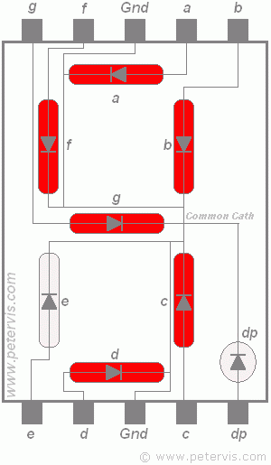
Applications of LED
1. Seven Segment Display
In the optical devices.
As ON-OFF indicator.

Slide 44

Applications of LED
2. Organic-LED
An OLED is any light emitting diode in which organic layers are responsible for light emission.
Main principle behind OLED technology is electroluminescence.
Electroluminescence is a process in which a material emits light in response to electrical field applied across it.

Slide 45
Features of OLED
Flexibility (in display)
Safe for environment
Light weight because of thin display
Less power consumption
High contrast, brighter and perfect display from all angles

Slide 46

Structure of OLED
Cathode- The cathode injects electrons
into emissive layer.
Emissive layer- This layer is made of
polyfluorene that transport electrons
from the cathode. This is where light is
made.
Conducting layer- This layer is made of
polyaniline that transport "holes" from
the anode.
Anode- It is kept transparent.
Usually made up of Indium tin oxide (ITO)
that removes electrons.
Substrate- The substrate supports the
OLED.

Slide 47

How it Works ??

Slide 48
Working of OLED
A voltage is applied across the anode and cathode
Current flows from cathode to anode through the organic layers
Electrons flow to emissive layer from the cathode
Electrons are removed from conductive layer leaving holes
Holes jump into emissive layer
Electron and hole combine and light emitted

Slide 49
Drawbacks of OLED
Complex fabrication methods
Expensive
Lifespan (Easily damageable)
Water damage
Colour balance issues

Slide 50

OLED Vs Others

Slide 51



Applications of OLED
Major applications of OLED technology are: OLED TV, Mobile phones with OLED screens, Rolltop Laptop.

Slide 52

Liquid Crystal Display
The Liquid Crystals are one of the most fascinating material systems in nature having properties of liquids as well as of a solid crystals.
The different arrangement of these liquid Crystals materials are:
1. Smectic 2. Nematic 3. Cholesteric

Slide 53

Liquid Crystal Display

Slide 54

Liquid Crystal Display

Slide 55

Liquid Crystal Display

Slide 56
Liquid Crystal Display
Advantages:
1. Less power consumption
2. Low cost.
3. Uniform brightness with good contrast.
4. Low operating voltage and current.
Disadvantages:
1. Poor reliability
2. Limited temperature range.
3. Poor visibility in low ambient temperature.
4. Slow speed.
5. Requires an AC drive.

Slide 57

LCDs Applications
7-segment displays.
Calculators, pagers and wrist-watch.
Flat panel display.
Alphanumeric display.

Slide 58
Difference between LEDs and LCDs
S. No. | Parameter | LED | LCD
1 | Power | 10 to 140 μW | 1 to 100 μW
2 | Voltages | 5 V | 3 to 18 V
3 | Temperature Range (⁰C) | -55 to 125 | 0 to 80
4 | Switching Speeds | 1 μs | 100 to 300 ms
5 | Life in hours | 100,000 + | 10,000
6 | Colors | Red, Orange, Yellow, Green | Depends on illumination
7 | Brightness | Good to excellent | Not applicable
8 | Ruggedness | Excellent | Good
9 | Ease of mounting | Excellent | Poor
10 | Applications | 1. 7-segment displays. 2. Indicator 3. Matrix displays | 7-segment displays Calculators, pagers and wrist-watch Flat panel display Alphanumeric display

Slide 59

Daily Quiz
The colour of emitting light in LED depends on ……….
(Material)
The LED emits light when ………………biased.
(Forward)
State applications of LCDs.

Slide 60
Weekly Assignment
Long Answer type Questions:
Q.1) Write Short notes on
i) LED ii) Seven Segment Display iii) LCD
Q.2) Explain the technology “Organic-Light Emitting Diode”.

Slide 61
Multiple Choice Questions
Q.1) The colour of emitted light from LED depends on Its physical dimensions Number of available carriers Type of semiconductor material used No. of recombinations taking place | Q.4) When forward biased, LED emits light because of Recombination of carriers Light generated in breaking covalent bonds Light produced by collisions All are correct
Q.2) The typical value of power consumption of LED is- Around 10mW Between 15 to 20 mW Between 30 to 40 mW Between 35 to 50 mW | Q.5) Electro-optical effect is produced in …… LED LCD O-LED OFC
Q.3) In 7-segment display, how many LEDs are used? 8 7 10 9 | Q.6) LCDs operate from a voltage ranges of …… 3 to 15 V 10 to 15 V 10 V 5 V

Slide 62

Questions from Previous Papers
Explain the Light Emitting Diodes (LED) with neat diagram. (2013-14)
Explain Liquid crystal Displays (LCD) with neat diagram. (2013-14)
Draw the symbol of LED. (2014-15)
Compare LED and LCD. (2014-15)
Compare LED and p-n junction diode. (2012-13)

Slide 63
Expected Questions for University Exam
Q.1) Explain principle of operation of Organic-LED. Also explain how it is different from LED?
Q.2) How can LED be used to make a 7-segment display?
Q.3) Explain principle of operation of LCD.

